Slide 1
计算机组成原理
---双语教学课件
计算机与通信学院
任学惠

Slide 2
William Stallings
Computer Organization and Architecture
6th Edition
Chapter 3
System Buses

Slide 3
§3.1 computer component
Program Concept
Hardwired systems are inflexible
Programmed manually by setting switches and plugging & unplugging cables
General purpose hardware can do different tasks, given correct control signals (go to )
Instead of re-wiring, supply a new set of control signals

Slide 4
What is a program?
A sequence of steps
For each step, an arithmetic or logical operation is done
For each operation, a different set of control signals is needed
一系列的步骤
每一步，完成一个算术或逻辑操作
每一次操作，需要一组不同的控制信号

Slide 5
Function of Control Unit
For each operation a unique code is provided
  e.g. ADD, MOVE
A hardware segment accepts the code and issues the control signals
We have a computer!
要为每一个操作提供一个唯一的编码 (相互区别)
硬件部分接受该编码并发布控制信号

Slide 6
Components
The Control Unit and the Arithmetic and Logic Unit constitute the Central Processing Unit
Data and instructions need to get into the system and results out
  Input/output
Temporary storage of code and results is needed
  Main memory
控制器和运算器构成CPU
系统要输入数据和指令，输出结果
需要暂时存储(数据的和指令的)编码和结果

Slide 7
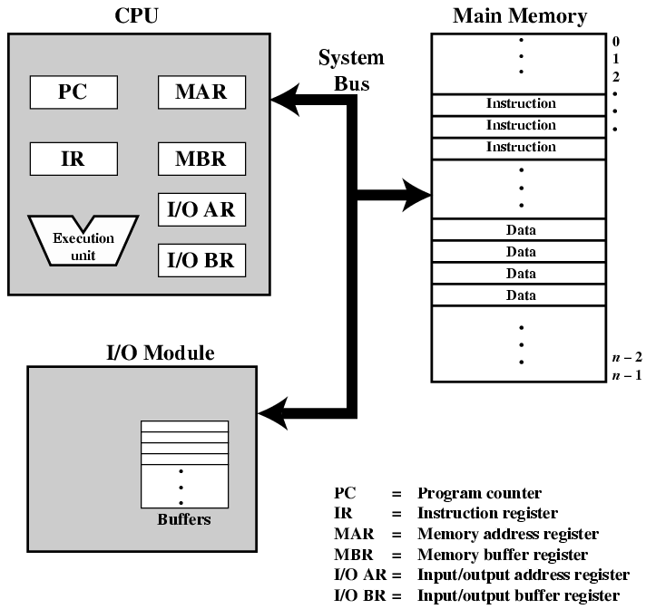
Computer Components:
Top Level View

Slide 8
Structure of components (charter 2 page 19)
Memory structure:
Memory contains of N storage locations, called word, of M digits( bits ).
Both data and instructions are stored there.
Data( numbers ) are represented in binary form.
Instructions also are binary code form.
Each storage location has a serial number to sign its position, the serial number calls address, from 0 to N-1.

Slide 9
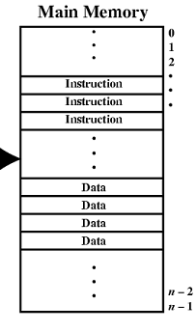
Memory structure
An instruction word
Address
from o to N-1
An data word

Slide 10
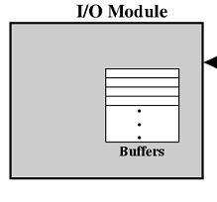
I/O structure
In an abstracted and simplified view, I/O is similar to memory.
Some words of storage

Slide 11
CPU structure
Some registers:
Memory buffer register(MBR): contains a word to be stored into memory, or a word just received from memory.
Memory Address Register(MAR): specifies the address in memory of read/write a word ( data or instruction).
Instruction buffer Register(IBR): holds temporarily an instruction code just fetched from memory

Slide 12
CPU structure
Instruction Register(IR): contains opcode of Instruction to be decoded.
Program counter(PC): contains the address of the next instruction in memory.
Accumulator (AC or Acc): holds temporarily a data word (an operand or a result of ALU operation).

Slide 13
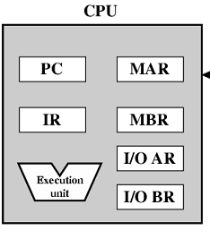
Cpu structure
AC , IBR is not necessary for connection

Slide 14
Connection for data transferring

Slide 15

§3.2 computer function
Instruction Cycle page53
Two steps (of an INSTRUCTION cycle):
  Fetch (取指令)
  Execute (执行指令)

Slide 16
Fetch Cycle ( Fetch subcycle) page54
Program Counter (PC) holds address of next instruction to fetch
Processor fetches instruction from memory location pointed to by PC
Increment PC
    Unless told otherwise
Instruction loaded into Instruction Register (IR)
Processor interprets instruction and performs required actions (issues control signals)

Slide 17
Execute Cycle (or Execute subcycle)
Processor-memory
  data transfer between CPU and main memory
Processor -I/O
  Data transfer between CPU and I/O module
Data processing
  Some arithmetic or logical operation on data
Control
  Alteration of sequence of operations
  e.g. jump
Combination of above

Slide 18
Instruction format page55
0001 1001 0100 0000 =>1 940H
Means Load data to from 940H of Memory
0101 1001 0100 0001 =>5 941H
Means Add AC with data from 941H
0010 1001 0100 0010 => 2 942H
Means Store data in AC to 942H
15
12
11
0
opcode
Address code
Opcode:0001=Load AC from Memory
0010=Store AC to Memory
0101=Add to AC from Memory

Slide 19
Program consists of 3 instruction:
Address instruction note
300 1940 load AC from 940(M)
301 5941 add to AC from 941(M)
302 2941 store AC to 941(M)
Address data value
940 0003 3
941 0002 2

Slide 20
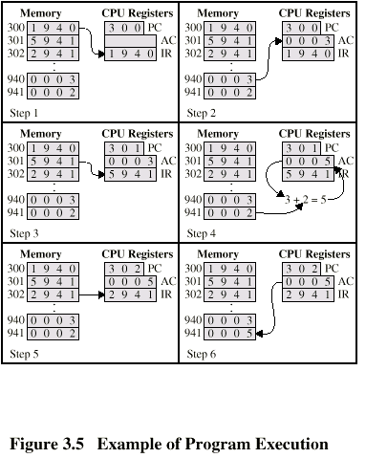
Example of Program Execution page56

Slide 21
The operation of Each instruction contains 2 actions with memory :
Fetch instruction from memory according to PC
Fetch / store data from / to memory according to address in instruction.(read/write →access)
Thinking : memory speed is so slower , 2 times of memory actions means that CPU must wait the memory performing.
I.e. in PDP-11, the instruction
ADD B,A means fetch instruction
fetch B ，fetch A
store to A after addition

Slide 22
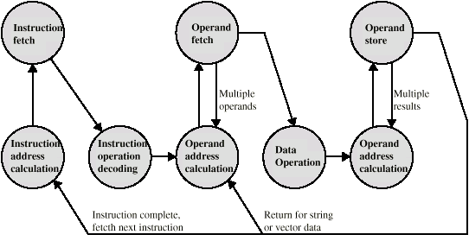
Instruction Cycle - State Diagram page57

Slide 23
Interrupts page58
Mechanism by which other modules (e.g. I/O) may interrupt normal sequence of processing
Program
  e.g. overflow, division by zero
Timer
  Generated by internal processor timer
  Used in pre-emptive multi-tasking
I/O
  from I/O controller
Hardware failure
  e.g. memory parity error

Slide 24
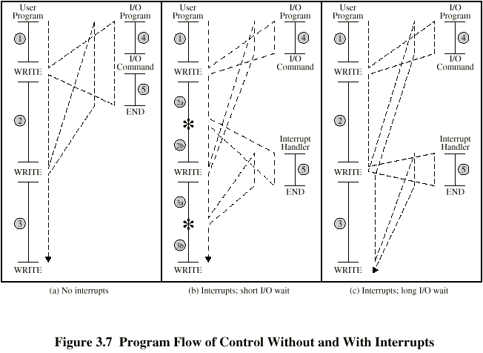
Program Flow Control

Slide 25
Interrupt Cycle(or Interrupt subcycle) page59
Added to instruction cycle
Processor checks for interrupt
  Indicated by an interrupt signal
If no interrupt, fetch next instruction

Slide 26
Interrupt Cycle(or Interrupt subcycle) page59
If interrupt pending(未处理):
  Suspend execution of current program
  Save context
  Set PC to start address of interrupt handler routine
  Process interrupt ………
  Restore context and continue interrupted program

Slide 27

Transfer of Control via Interrupts page61
processing
branching
suspending
resuming

Slide 28

Instruction Cycle with Interrupts

Slide 29
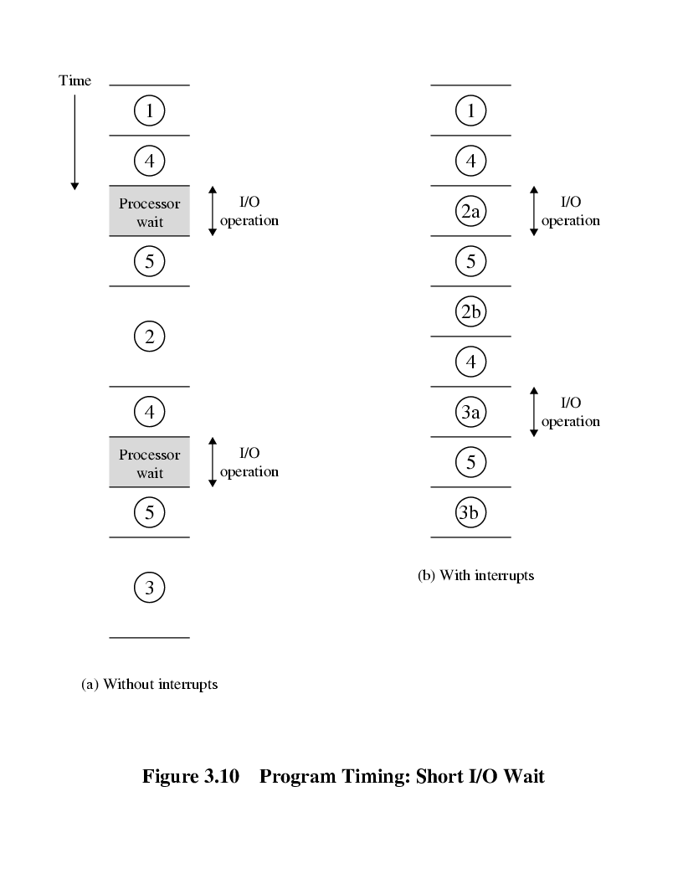
Program Timing short I/O Wait page62
Return and wait interrupt
Call I/O 1 ….
Call I/O 2…
interrupt
Return user…
Interrupt handler
在2a期间，CPU执行用户程序和I/O操作是同时进行的. 5作为中断处理中断了用户程序2

Slide 30
Program Timing
Long I/O Wait

Slide 31
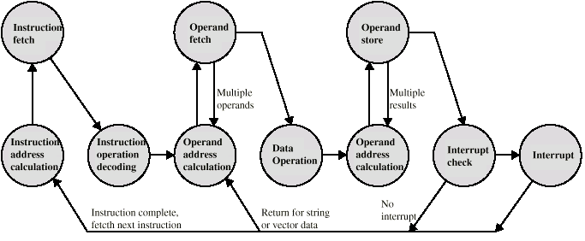
Instruction Cycle (with Interrupts) - State Diagram page65

Slide 32
Multiple Interrupts page64
Disable interrupts
  Processor will ignore further interrupts while processing one interrupt
  Interrupts remain pending and are checked after first interrupt has been processed
  Interrupts handled in sequence as they occur

Slide 33

Multiple Interrupts – Sequential page66

Slide 34
Multiple Interrupts page64
Define priorities(优先级)
  Low priority interrupts can be interrupted by higher priority interrupts
  When higher priority interrupt has been processed, processor returns to previous interrupt (in nest as they occur)

Slide 35
Multiple Interrupts – Nested page66

Slide 36

Time Sequence of Multiple Interrupts page67
fastest
middle
slowest

Slide 37
§3.3 interconnection structure page67
All the units must be connected
Different type of connection for different type of unit
  Memory
  Input/Output
  CPU

Slide 38

Computer Modules

Slide 39
Memory Connection page68
Receives and sends data
Receives addresses (of locations)
Receives control signals
  Read
  Write
  Timing

Slide 40
Input/Output Connection(1)
Similar to memory from computer’s viewpoint
Output
  Receive data from computer
  Send data to peripheral
Input
  Receive data from peripheral
  Send data to computer

Slide 41
Input/Output Connection(2)
Receive control signals from computer
Send control signals to peripherals
  e.g. spin disk
Receive addresses from computer
  e.g. port number to identify peripheral
Send interrupt signals (control)

Slide 42
CPU Connection
Reads instruction and data
Writes out data (after processing)
Sends control signals to other units
Receives (& acts on) interrupts

Slide 43
Insertion
整数的位数确定了它的表示范围
例如：三位d₂d₁d₀的表示范围为000至999共10³=1000数
可以推出N位十进制整数表示范围为0至10^{N}-1，共10^{N}个数
继续：则N位二进制整数表示范围为0至2^{N}-1，共2^{N}个数
例如：四位b₃b₂b₁b₀可表示0000至1111共2⁴=16个数
N位的二进制地址编码可以在2^{N}个存储“字”中确定一个“字”------寻址范围(addressing range)或称为存储空间(memory space)

Slide 44
§3.4 Bus interconnection page69
There are a number of possible interconnection systems
Single and multiple BUS structures are most common
e.g. Control/Address/Data bus (PC)
e.g. Unibus (DEC-PDP)

Slide 45
What is a Bus?
A communication pathway connecting two or more devices
Usually broadcast
Often grouped
  A number of channels in one bus
  e.g. 32 bit data bus is 32 separate single bit channels
Power lines may not be shown

Slide 46
Data Bus
Carries data
  Remember that there is no difference between “data” and “instruction” at this level
Width is a key determinant of performance
  8, 16, 32, 64 bit

Slide 47
Address bus
Identify the source or destination of data
e.g. CPU needs to read an instruction (data) from a given location in memory
Bus width determines maximum memory capacity of system
  e.g. 8080 has 16 bit address bus giving 64k address space

Slide 48
Control Bus
Control and timing information
  Memory read/write signal
  Interrupt request
  Clock signals

Slide 49

Bus Interconnection Scheme

Slide 50
Big and Yellow?
What do buses look like?
  Parallel lines on circuit boards
  Ribbon cables
  Strip connectors on mother boards
    e.g. PCI
  Sets of wires

Slide 51
The operation of bus page 71
some modules(Initiaors:CPU) can do 2 things: (somes just only are passtive targets:memory)
Send (or write, store)
Obtain the use of bus
Send the target address & control signal
Transfer data to the target module via the data line
Request ( or fetch , read)
Obtain the use of bus
Transfer a request control to the other module pointed by address lines
Wait for data from the other module

Slide 52
Single Bus Problems
Lots of devices on one bus leads to:
  Propagation delays
    Long data paths mean that co-ordination of bus use can adversely affect performance
    If aggregate data transfer approaches bus capacity
Most systems use multiple buses to overcome these problems

Slide 53

Traditional (ISA) (with cache) page73

Slide 54
High Performance Bus page73

Slide 55
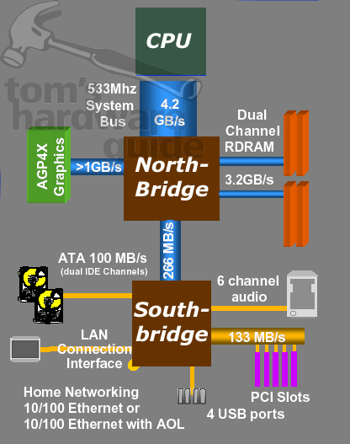

Slide 56
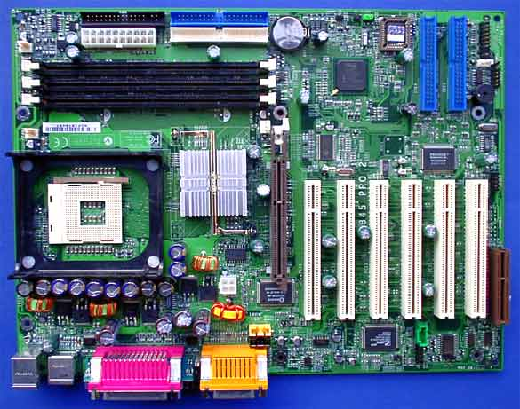

Slide 57
Bus Types
Dedicated
  Separate data & address lines
Multiplexed
  Shared lines(data & address共用，时间分前后，再加控制信号)
  Address valid or data valid control line
  Advantage - fewer lines
  Disadvantages
    More complex control
    Ultimate performance

